Slide 1
Introduction to
International Business Administration

Slide 2
Entering Foreign Markets

Slide 3
Prof. Dr. Amit Shah
Notes:
This is a test

Slide 4
Basic Entry Decisions
Three Expansion Decisions
  Which markets to enter.
  When to enter them.
  Scale of entry.

Slide 5
Introduction
Ways to Enter Foreign Markets
  Exporting.
  Licensing or franchising to host-country firms.
  Creating a joint venture with a host-country firm.
  Creating a wholly owned subsidiary in the host country.
  Acquiring an established enterprise in the host country.
Notes:
This chapter is concerned with two closely related topics: (1) the decision of which foreign markets to enter, when to enter them, and on what scale; and (2) the choice of entry mode.

Slide 6
Introduction
Considering Advantages and Disadvantages of Entry Modes
  Transportation costs.
  Trade barriers.
  Political risks.
  Economic risks.
  Business risks.
  Costs.
  Firm strategy.
Notes:
Each of mode of entry has advantages and disadvantages. The magnitude of the advantages and disadvantages associated with each entry mode is determined by a number of factors, including transport costs, trade barriers, political risks, economic risks, business risks, costs, and firm strategy. The optimal entry mode varies by situation, depending on these factors.

Slide 7
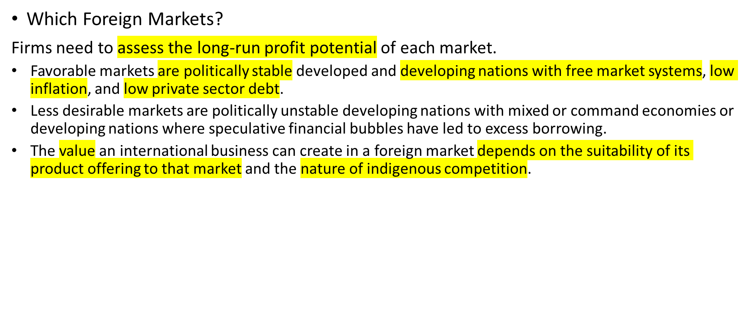
Basic Entry Decisions
Notes:
The attractiveness of a country as a potential market for an international business depends on balancing the benefits, costs, and risks associated with doing business in that country.

Slide 8
Basic Entry Decisions
Timing of Entry
  After a firm identifies which market to enter, it must determine the timing of entry.
    Early entry is when a firm enters a foreign market before other foreign firms.
    Late entry is when a firm enters after other firms have already established themselves in the market.
Notes:
First:
advantage: you can established there; “youre the first”; better expansion
risk:

Slide 9
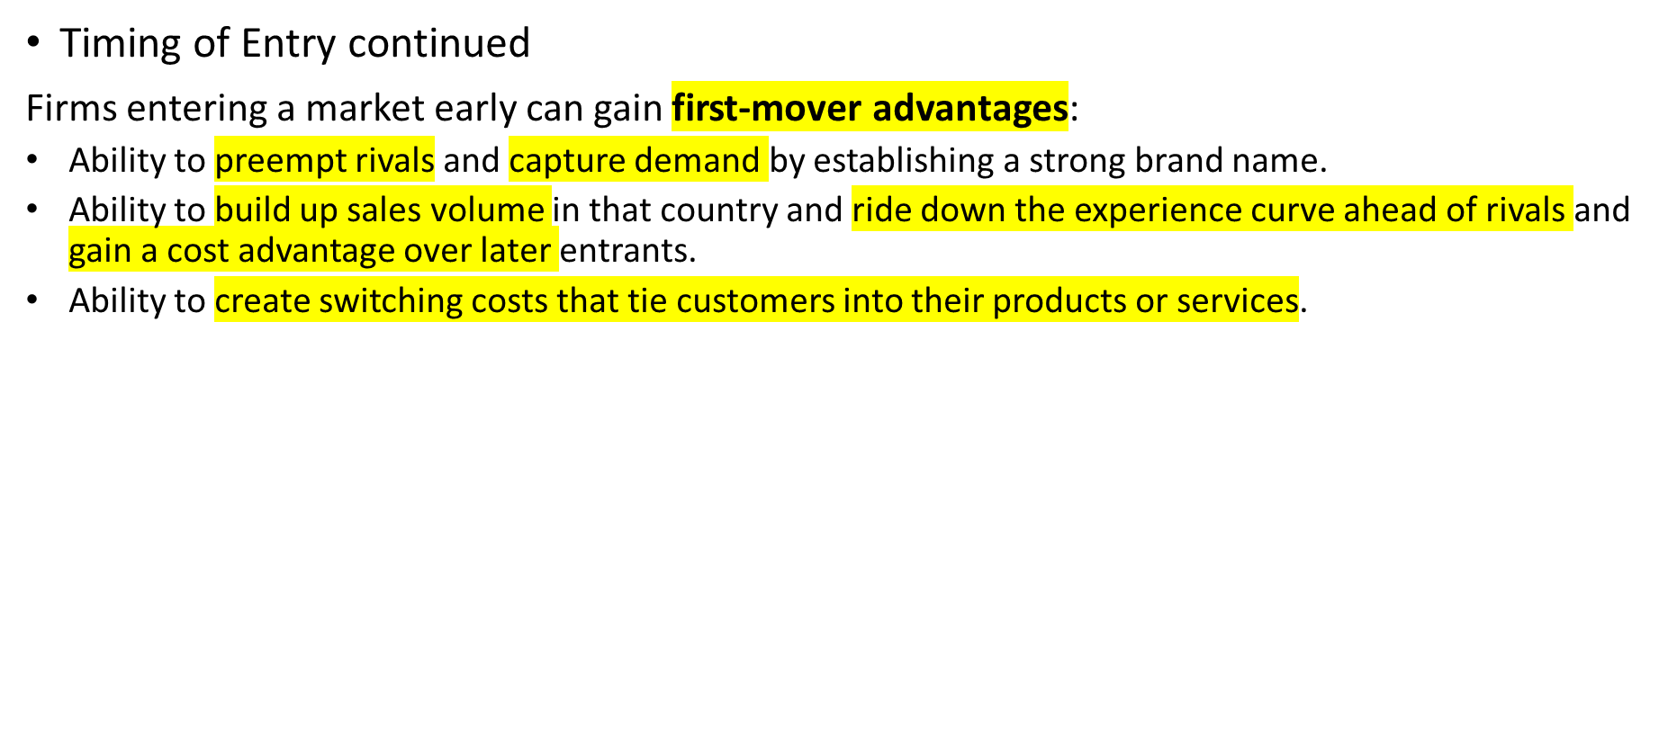
Basic Entry Decisions
Notes:
Switching costs make it difficult for later entrants to win business.
Later arrivals will be compared to the first entry company

Slide 10
Basic Entry Decisions
Timing of Entry continued
  First-mover disadvantages: the disadvantages associated with entering a foreign market before other international businesses.
  May result in pioneering costs—costs that an early entrant bears that a later entrant can avoid—such as:
    Costs of business failure if the firm, due to its ignorance of the foreign environment, makes some major mistakes.
    Costs of promoting and establishing a product offering, including the cost of educating customers.
Notes:
An early entrant may be put at a severe disadvantage, relative to a later entrant, if regulations change in a way that diminishes the value of an early entrant’s investments. This is a serious risk in many developing nations where the rules that govern business practices are still evolving. Early entrants can find themselves at a disadvantage if a subsequent change in regulations invalidates prior assumptions about the best business model for operating in that country.

Slide 11
Basic Entry Decisions
Scale of Entry and Strategic Commitments
  Entering foreign markets on a significant scale make a major strategic commitment that changes the competitive playing field.
    Involves decisions that have a long-term impact and are difficult to reverse.
  Small-scale entry can allow the firm to learn about a foreign market, while limiting the firm’s exposure to that market.
    Reduces the risks associated with a subsequent large-scale entry.
    May be more difficult to build market share.
    Test out market first
Notes:
Significant strategic commitments are neither unambiguously good nor bad. Rather, they tend to change the competitive playing field and unleash a number of changes, some of which may be desirable and some of which will not be. It is important for a firm to think through the implications of large-scale entry into a market and act accordingly.
Large scale entry = giant risk
Small = test a market
n.1 issue for entering new markets is beaurocracy

Slide 12
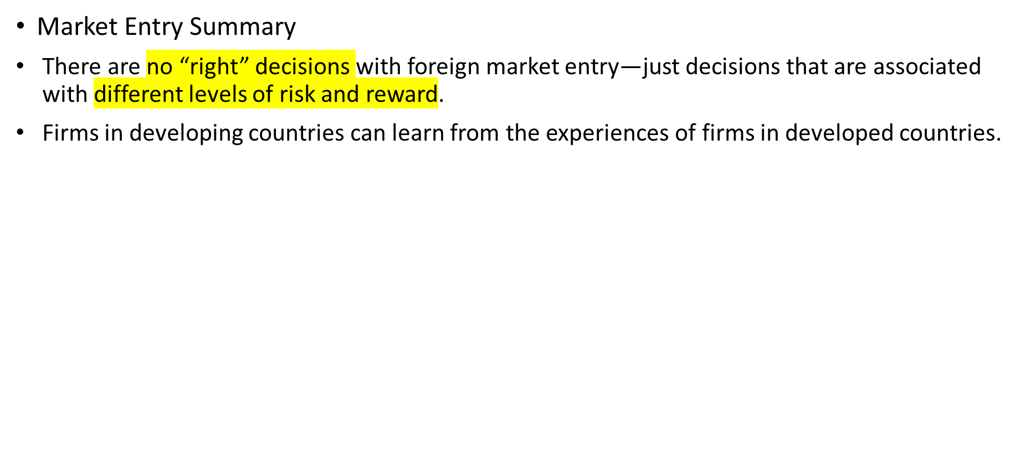
Basic Entry Decisions
Notes:
Christopher Bartlett and Sumantra Ghoshal have pointed out the ability that businesses based in emerging countries have to enter foreign markets and become global players. Although such firms tend to be late entrants into foreign markets and although their resources may be limited, Bartlett and Ghoshal argue that such late movers can still succeed against well-established global competitors by pursuing appropriate strategies.

Slide 13
Entry Modes
Modes to Enter Foreign Markets
  Exporting.
  Turnkey projects.
  Licensing.
  Franchising.
  Joint ventures.
  Wholly owned subsidiaries.
Notes:
Each entry mode has advantages and disadvantages. Managers need to consider these carefully when deciding which to use.
From easy to difficult/risky

Slide 14
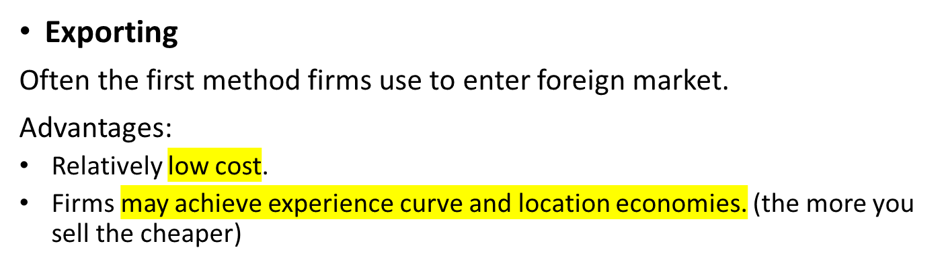
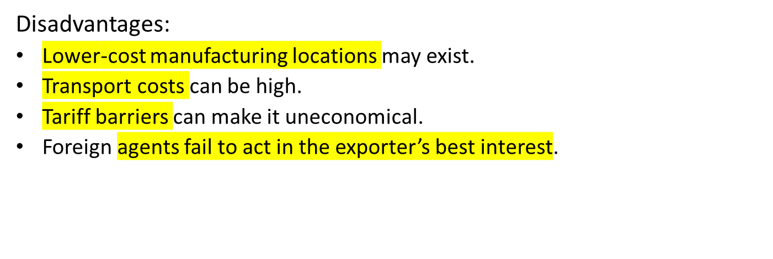
Entry Modes
Notes:
Exporting is the sale of products produced in one country to residents of another country.
The way around certain disadvantages is to set up wholly owned subsidiaries in foreign nations to handle local marketing, sales, and service. By doing this, the firm can exercise tight control over marketing and sales in the country while reaping the cost advantages of manufacturing the product in a single location or a few choice locations.

Slide 15
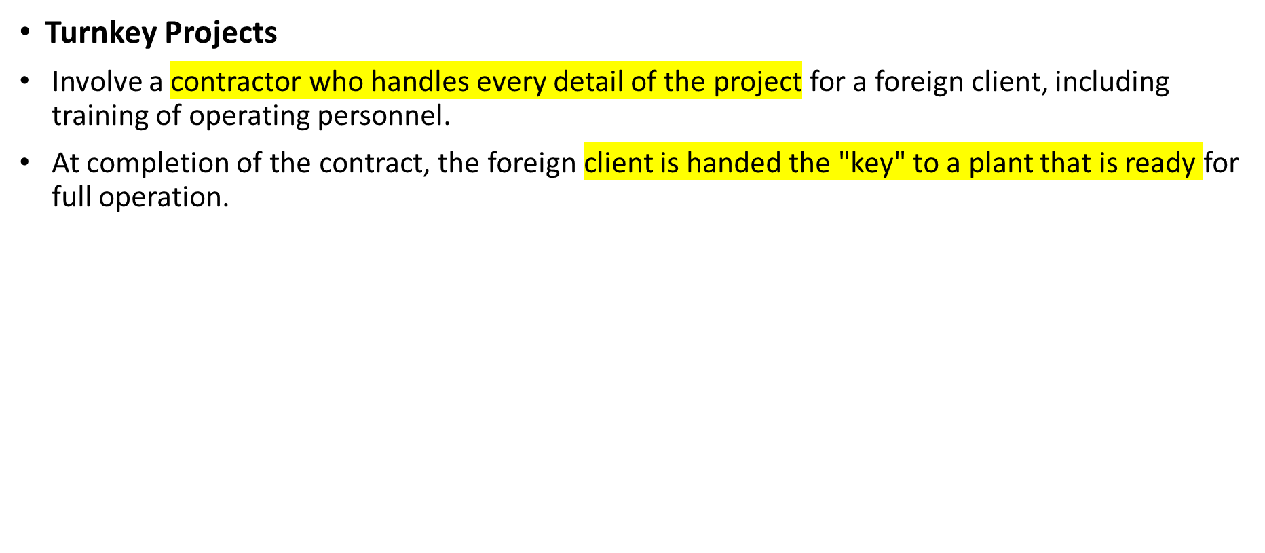
Entry Modes
Notes:
Turnkey projects are most common in the chemical, pharmaceutical, petroleum-refining, and metal-refining industries, all of which use complex, expensive production technologies.

Slide 16
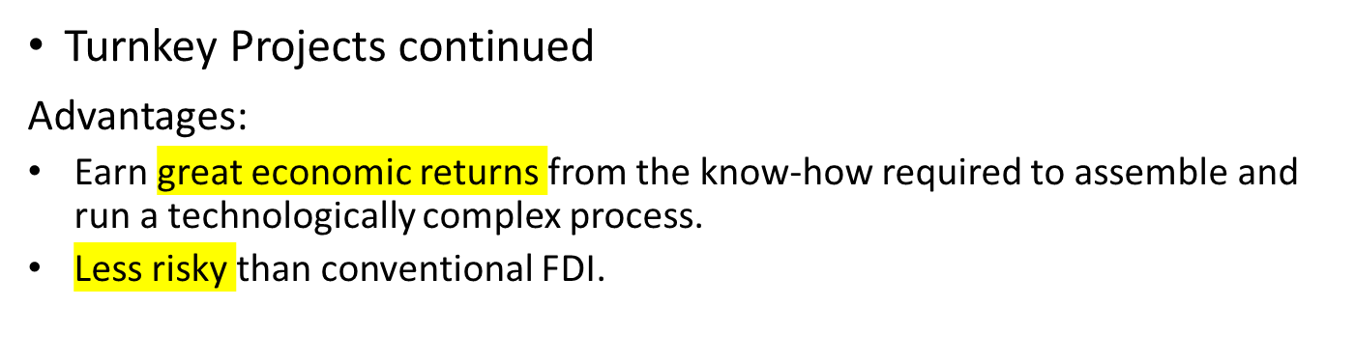
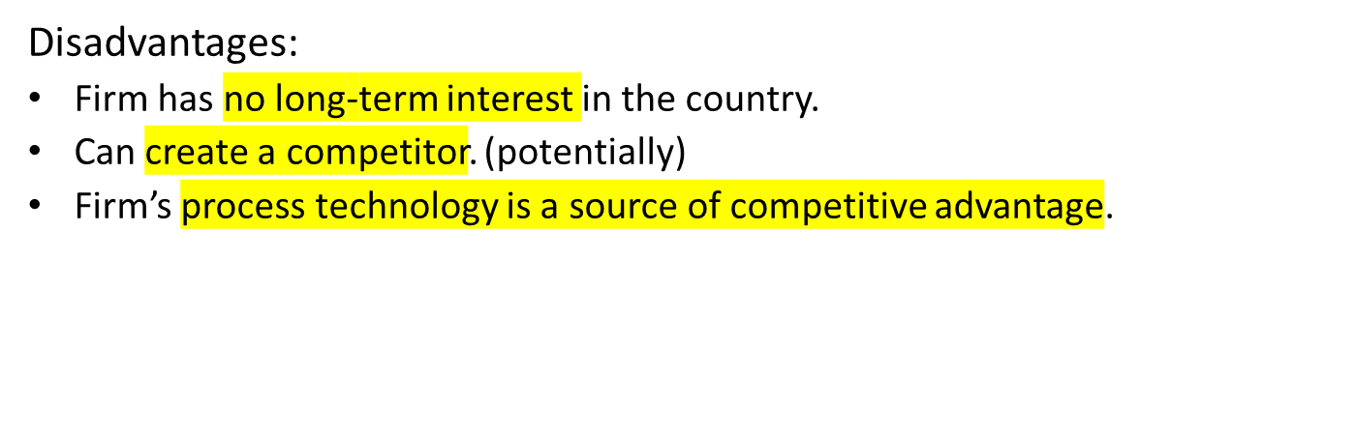
Entry Modes
Notes:
Turnkey strategy is particularly useful where foreign direct investment (FDI) is limited by host-government regulations.
Engineering procurements contractors = companies who build turnkeys

Slide 17
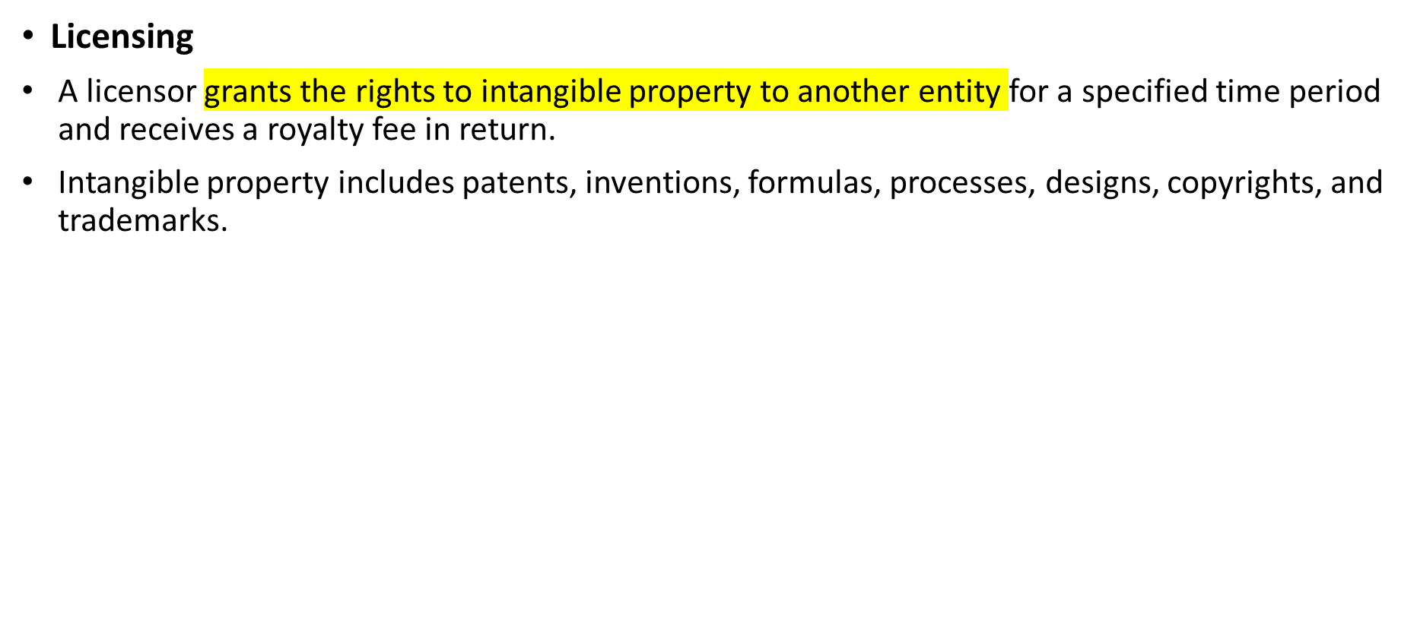
Entry Modes
Notes:
Intangible property includes patents, inventions, formulas, processes, designs, copyrights, and trademarks. For example, to enter the Japanese market, Xerox, inventor of the photocopier, established a joint venture with Fuji Photo that is known as Fuji Xerox. Xerox then licensed its xerographic know-how to Fuji Xerox. In return, Fuji Xerox paid Xerox a royalty fee equal to 5 percent of the net sales revenue that Fuji Xerox earned from the sales of photocopiers based on Xerox’s patented know-how.

Slide 18
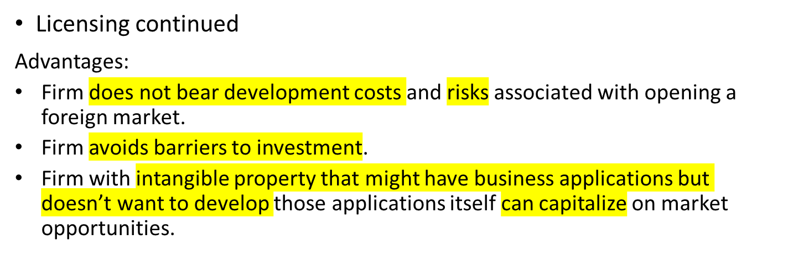
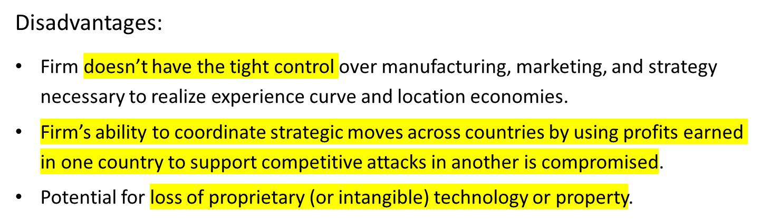
Entry Modes
Notes:
There are ways of reducing this risk. One way is by entering into a cross-licensing agreement with a foreign firm. Under a cross-licensing agreement, a firm might license some valuable intangible property to a foreign partner, but in addition to a royalty payment, the firm might also request that the foreign partner license some of its valuable know-how to the firm.
Another way of reducing the risk associated with licensing is to follow the Fuji Xerox model and link an agreement to license know-how with the formation of a joint venture in which the licensor and licensee take important equity stakes.

Slide 19
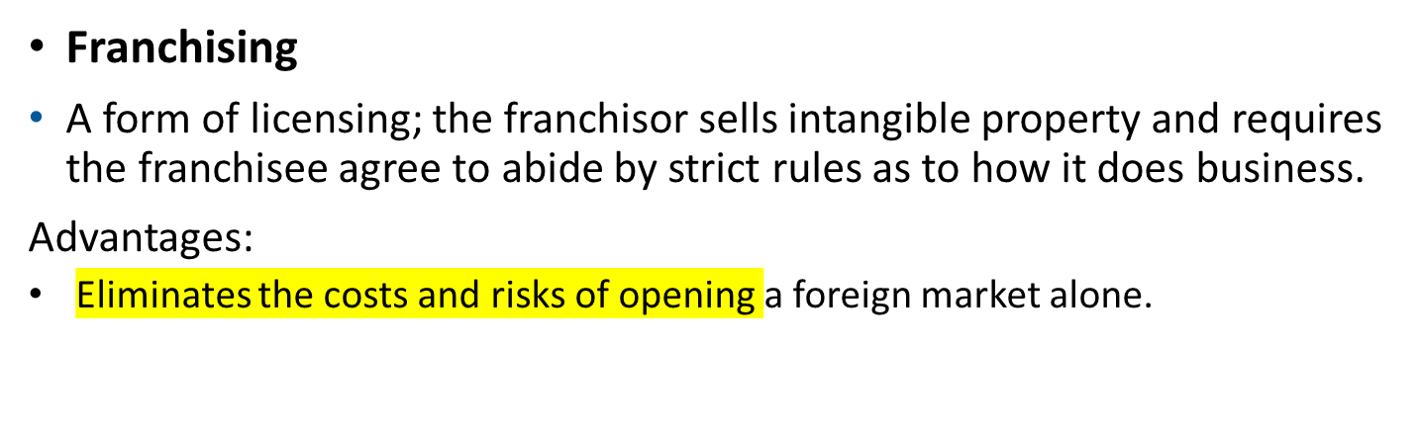
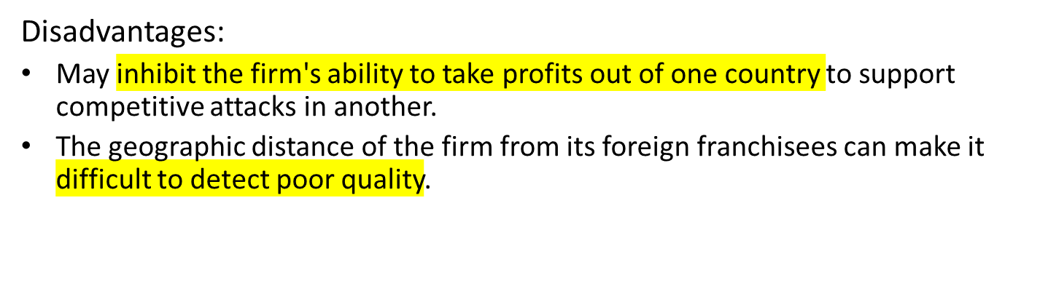
Entry Modes
Notes:
McDonald’s is a good example of a firm that has grown and taken advantage of a franchising strategy. McDonald’s strict rules as to how franchisees should operate a restaurant extend to control over the menu, cooking methods, staffing policies, and design and location. McDonald’s also organizes the supply chain for its franchisees and provides management training and financial assistance.

Slide 20
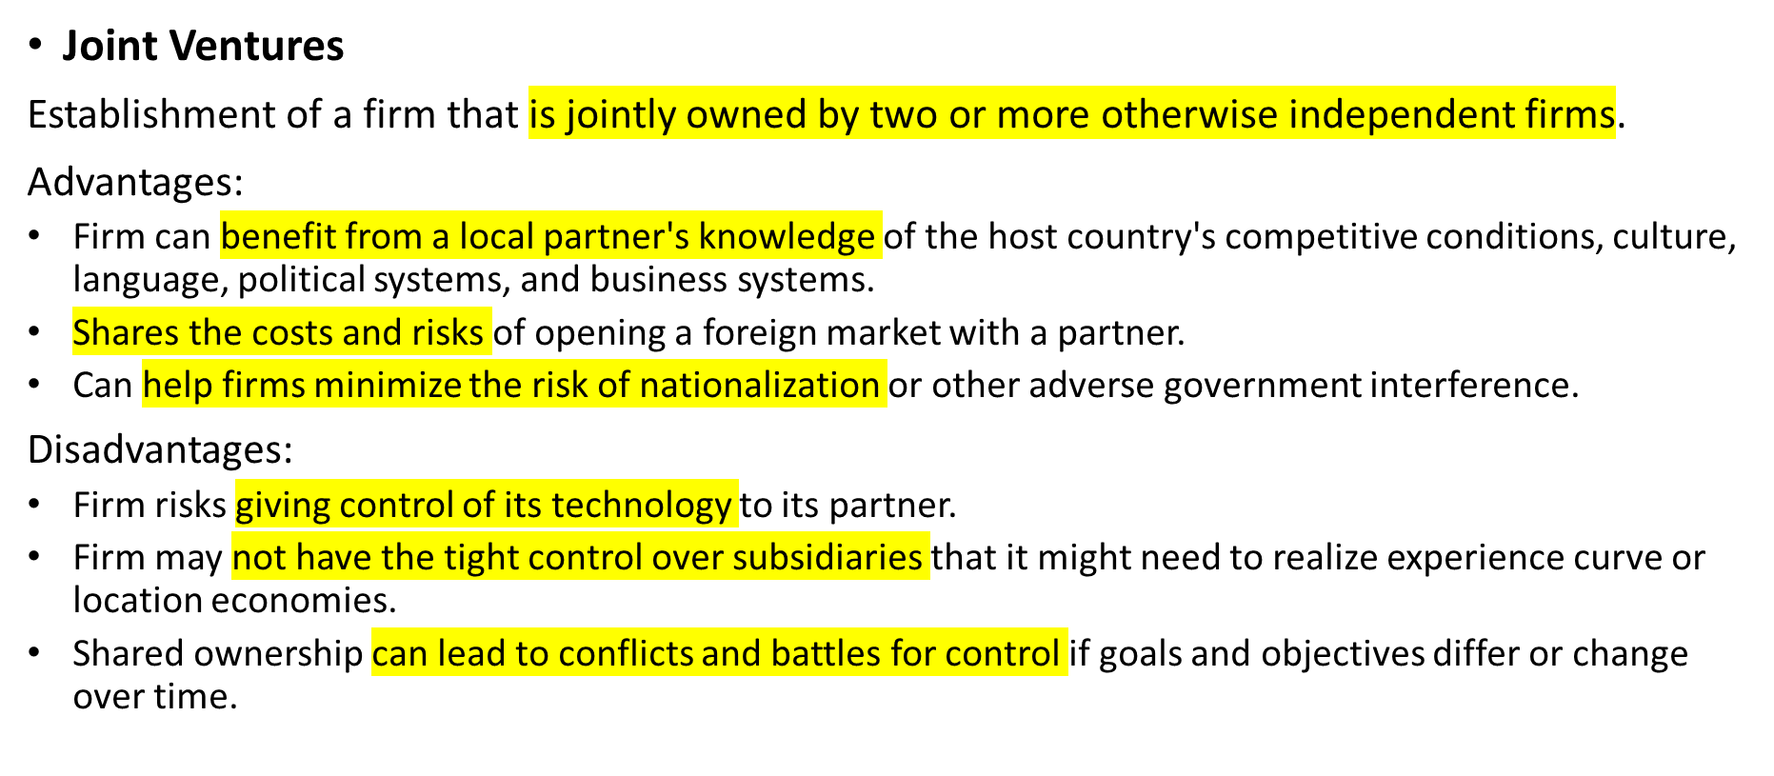
Entry Modes
Notes:
The most typical joint venture is a 50–50 venture, in which there are two parties, each holding a 50 percent ownership stake and contributing a team of managers to share operating control.
There are major disadvantages with joint ventures. First, as with licensing, a firm that enters into a joint venture risks giving control of its technology to its partner.
Thus, a proposed joint venture in 2002 between Boeing and Mitsubishi Heavy Industries to build a new wide-body jet (the 787) raised fears that Boeing might unwittingly give away its commercial airline technology to the Japanese. However, joint-venture agreements can be constructed to minimize this risk.
One option is to hold majority ownership in the venture. This allows the dominant partner to exercise greater control over its technology. But it can be difficult to find a foreign partner who is willing to settle for minority ownership.
Another option is to “wall off” from a partner technology that is central to the core competence of the firm, while sharing other technology.

Slide 21
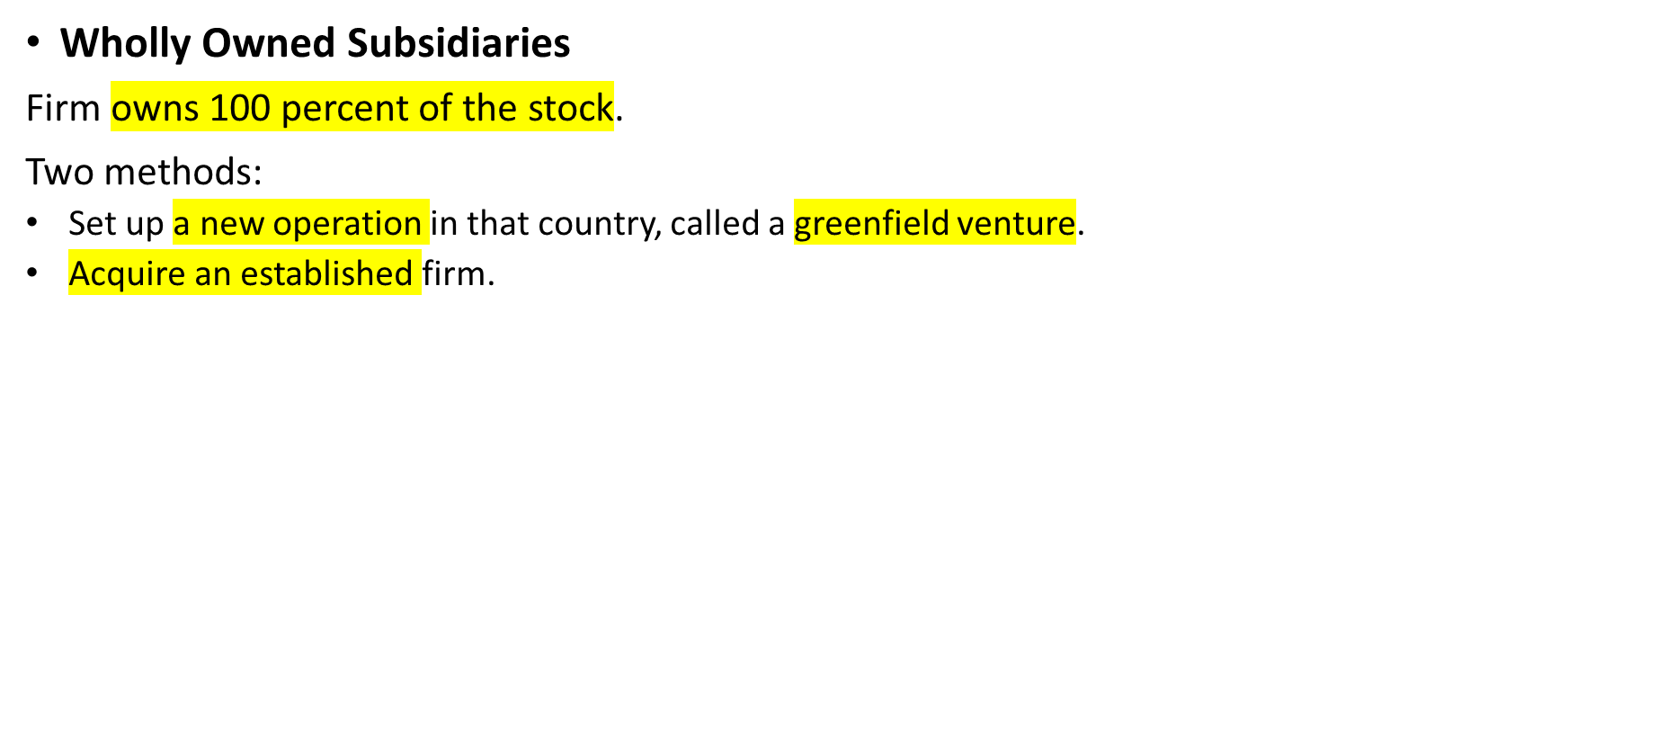
Entry Modes

Slide 22
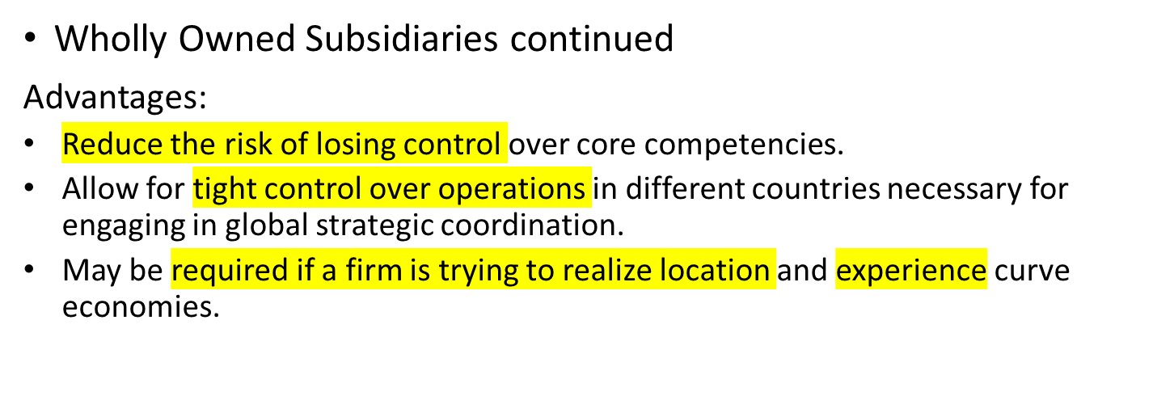
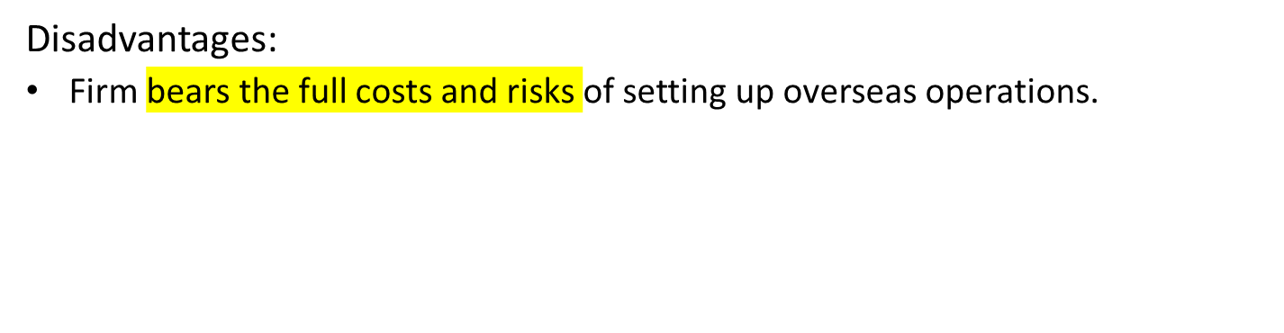
Entry Modes
Notes:
When a firm’s competitive advantage is based on technological competence, a wholly owned subsidiary will often be the preferred entry mode because it reduces the risk of losing control over that competence.

Slide 23
Table: Advantages and Disadvantages of Entry Modes
Entry Mode | Advantages | Disadvantages
Exporting | Ability to realize location and experience curve economies. Increased speed and flexibility of engaging target markets. | High transport costs. Trade barriers. Problems with local marketing agents.
Turnkey contracts | Ability to earn returns from process technology skills in countries where FDI is restricted. | Creation of efficient competitors. Lack of long-term market presence.
Licensing | Low development costs and risks. Moderate involvement and commitment. | Lack of control over technology. Inability to realize location and experience curve economies. Inability to engage in global strategic coordination.
Franchising | Low development costs and risks. Possible circumvention of import barriers, and strong sales potential. | Lack of control over quality. Inability to engage in global strategic coordination.

Slide 24
Table: Advantages and Disadvantages of Entry Modes
Entry Mode | Advantages | Disadvantages
Joint ventures | Lack of control over quality. Inability to engage in global strategic coordination. | Lack of control over technology. Inability to engage in global strategic coordination. Inability to realize location and experience economies.
Wholly owned subsidiaries | Protection of technology. Ability to engage in global strategic coordination. Ability to realize location and experience economies. | High costs and risks. Need for more human and nonhuman resources, and interaction and integration with local employees.

Slide 25
Selecting an Entry Mode
Core Competencies and Entry Mode
  Technological Know-How.
    When competitive advantage is based on proprietary technological know-how, firms should avoid licensing and joint venture arrangements in order to minimize the risk of losing control over the technology.
    If a technological advantage is only transitory or the firm can establish its technology as the dominant design in the industry, licensing may be attractive.
Notes:
The optimal entry mode for these firms depends to some degree on the nature of their core competencies. A distinction can be drawn between firms whose core competency is in technological know-how and those whose core competency is in management know-how.

Slide 26
Selecting an Entry Mode
Core Competencies and Entry Mode continued
Management Know-How.
    The competitive advantage of many service firms is based upon management know-how.
    International trademark laws are generally effective for protecting trademarks.
    The risk of losing control over management skills to franchisees or joint venture partners is low.
      Allows for greater use of brand names, which is the most valuable asset.
Notes:
The competitive advantage of many service firms is based on management know-how (e.g., McDonald’s, Starbucks). For such firms, the risk of losing control over the management skills to franchisees or joint-venture partners is not that great.

Slide 27
Selecting an Entry Mode
Pressures for Cost Reductions and Entry Mode
  Firms facing strong pressures for cost reductions are likely to pursue some combination of exporting and wholly owned subsidiaries.
    Allows the firm to achieve location and scale economies as well as retain some degree of control over worldwide product manufacturing and distribution.
    Firms pursuing global standardization or transnational strategies tend to establish wholly owned subsidiaries.
Notes:
Setting up wholly owned marketing subsidiaries can be preferable to joint-venture arrangements and to using foreign marketing agents because it gives the firm tight control that might be required for coordinating a globally dispersed value chain.

Slide 28
Greenfield Venture or Acquisition?
Pros and Cons of Acquisitions
  Are quick to execute.
  Enable firms to preempt their competitors.
  Can be less risky than greenfield ventures.
  However, many acquisitions are not successful.
Notes:
The volume of cross-border acquisitions has been growing at a rapid rate for two decades. Over most of the past decades, between 40 and 80 percent of all foreign direct investment (FDI) inflows have been in the form of mergers and acquisitions.

Slide 29
Greenfield Venture or Acquisition?
Pros and Cons of Acquisitions continued
  Why Do Acquisitions Fail?
    Firm overpays for the assets of the acquired firm.
    Clash between the cultures of the acquiring and acquired firm.
    Attempts to realize gains by integrating the operations of the acquired and acquiring entities run into roadblocks and take much longer than forecast.
    Inadequate pre-acquisition screening.
Notes:
The management of the acquiring firm is often too optimistic about the value that can be created via an acquisition and is thus willing to pay a significant premium over a target firm’s market capitalization. This is called the “hubris hypothesis” of why acquisitions fail. The hubris hypothesis postulates that top managers typically overestimate their ability to create value from an acquisition, primarily because rising to the top of a corporation has given them an exaggerated sense of their own capabilities.

Slide 30
Greenfield Venture or Acquisition?
Pros and Cons of Acquisitions continued
  Reducing the Risks of Failure.
    Through careful screening of the firm to be acquired.
    By moving rapidly once the firm is acquired to implement an integration plan.
Notes:
Screening can help to make sure the firm (1) does not pay too much for the acquired unit, (2) does not uncover any nasty surprises after the acquisition, and (3) acquires a firm whose organization culture is not antagonistic to that of the acquiring enterprise.

Slide 31
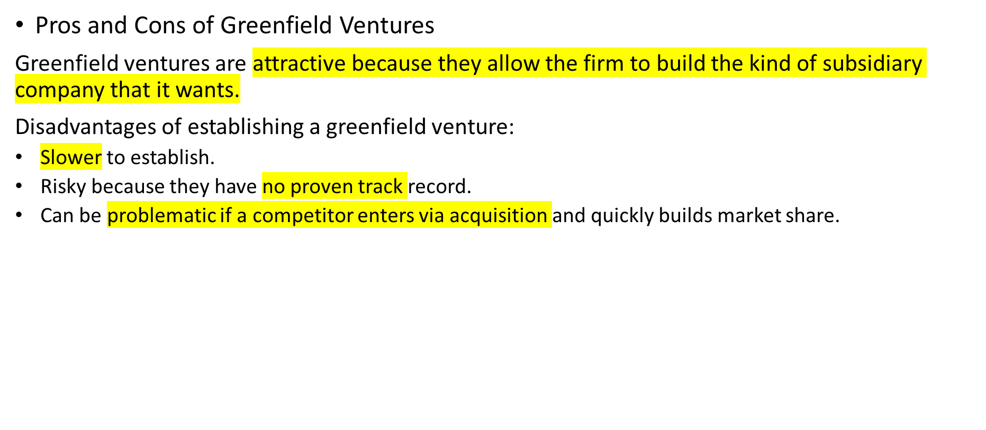
Greenfield Venture or Acquisition?
Notes:
The big advantage of establishing a greenfield venture in a foreign country is that it gives the firm a much greater ability to build the kind of subsidiary company that it wants. For example, it is much easier to build an organization culture from scratch than it is to change the culture of an acquired unit. Similarly, it is much easier to establish a set of operating routines in a new subsidiary than it is to convert the operating routines of an acquired unit.
If the firm has already been successful in other foreign markets and understands what it takes to do business in other countries, these risks may not be that great.

Slide 32
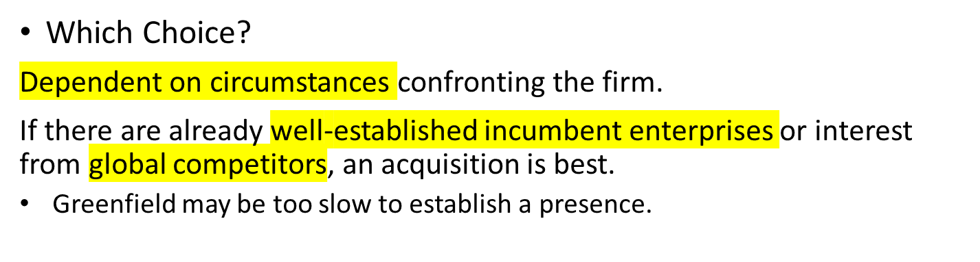
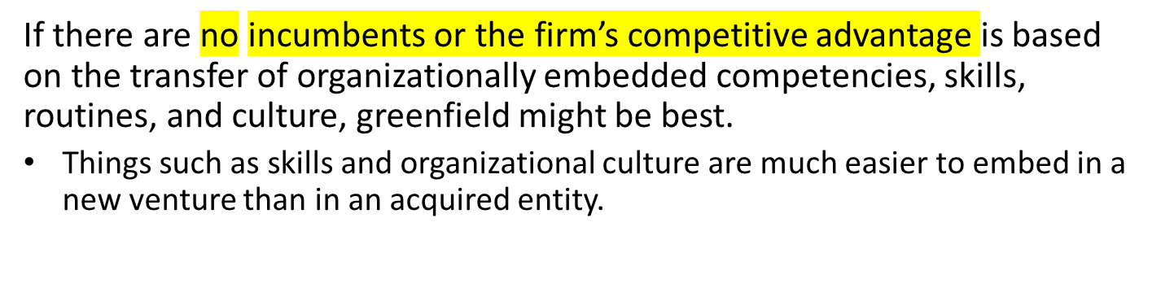
Greenfield Venture or Acquisition?
Notes:
The choice between acquisitions and greenfield ventures is not an easy one. Both modes have their advantages and disadvantages.

Slide 33
End of Entering Foreign Markets Lecture

